Slide 1
Collection of slides for Prelim review

Slide 2
ATP & NADH as common currencies of energy and electrons, respectively
From CEE451 reader Chapter 17

Slide 3
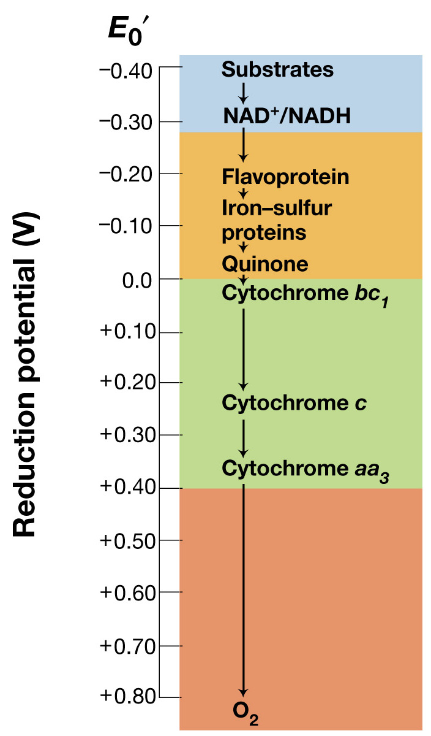
Redox tower for common Electron Transport Chain (ETC) components
Figure: 05-19
Notes:
Figure: 05-19
Caption:
Electron transport chains and their relation to E₀'. Shown here is one example of an electron transport system, leading to the transfer of electrons from substrate to O₂. This particular sequence is typical of the electron transport chain of the mitochondrion of eukaryotic cells and that of some Bacteria (for example, Paracoccus denitrificans). The electron transport chain in Escherichia coli lacks cytochromes c and aa₃, and instead electrons go directly from cytochrome b to cytochrome o or d (the latter has a similar E₀' to cytochrome aa₃), which is the terminal oxidase (Figure 17.37). By breaking up the complete oxidation into a series of discrete steps, energy conservation is possible through proton motive force formation leading to ATP synthesis. Compare color-coding here with those in Figure 5.9.

Slide 4
Bioenergetics packet (from Jim Gossett). Cells metabolism is balanced energetically & materially: example of chemoorganoheterotroph using NH3 as N-source
ΔG₁= (1-ɛ)AΔG_{r}
ɛAΔG_{r}
ΔG_{s}
AΔG_{r}

Slide 5
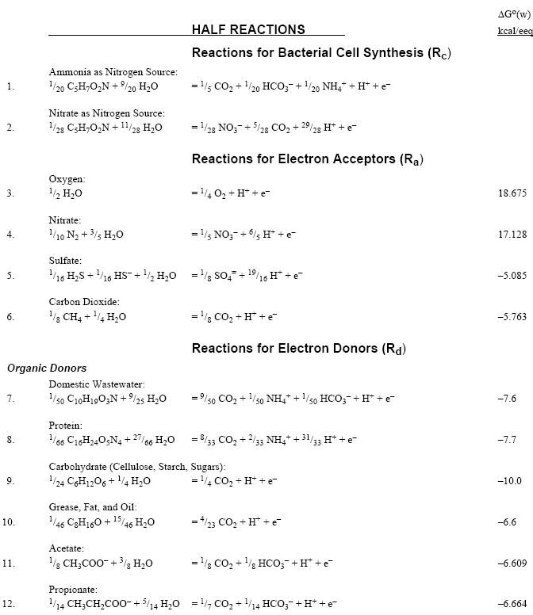

Slide 6
Balanced catabolic summary reaction for aerobic glucose respiration
Note: 1 eeq reduces ¼ mole O2 to water (1/4 mole O2 = 32/4 = 8 g O2)
Therefore 1 eeq of an electron donor imposes 8 g of Oxygen Demand (OD)

Slide 7
eeq conversions
1 eeq (1 mole e’s)= 8 g OD (oxygen demand) = 96,400 Coulombs
In electrical engineering:
1 Coulomb/s = 1 Ampere (a unit of current w symbol I)
Power in an electrical system = Volts*Current = Watts

Slide 8
A equations (with ammonia as N source)
Heterotrophs
Autotrophs
m = +1 (∆Gp > 0)
m = –1 (∆Gp < 0)
ɛ = 0.6 and ∆Gc = 7.5 kcal are usually assumed

Slide 9
From A values to yields

Slide 10
Of course, ΔG values vary from standard values if…
… you are far from “standard” conditions of pH7, 1 M all aqueous solutes and 1 atm of all gaseous compounds, 298K
Correction term can be key:

Slide 11
Fennell et al., ES&T, 1997&98

Slide 13
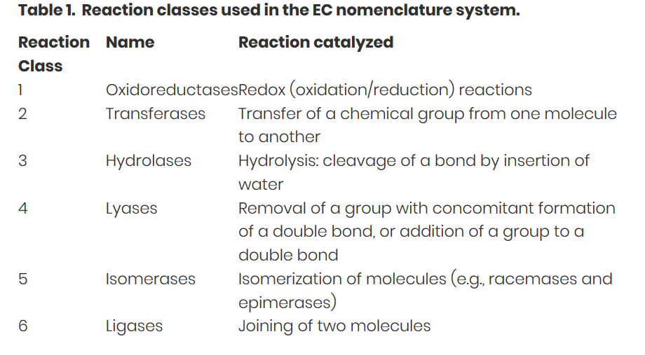
6 Functional Categories of Enzymes by the E.C. numbering system

Slide 14
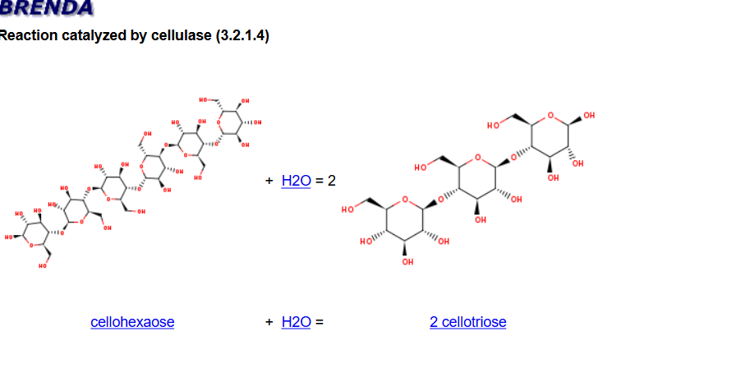
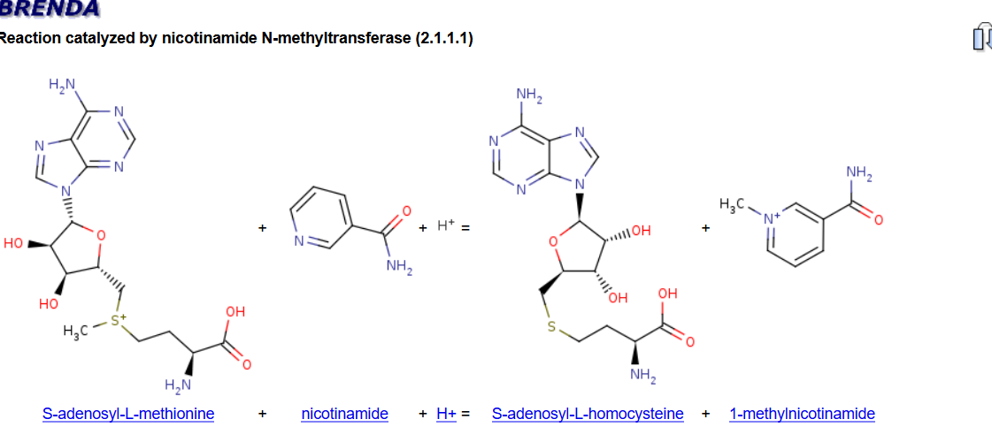
6 Functional Categories of Enzymes by the E.C. numbering system

Slide 15
Kinetics

Slide 16
Reactor types

Slide 17
CSTR S and Xa equations

Slide 18
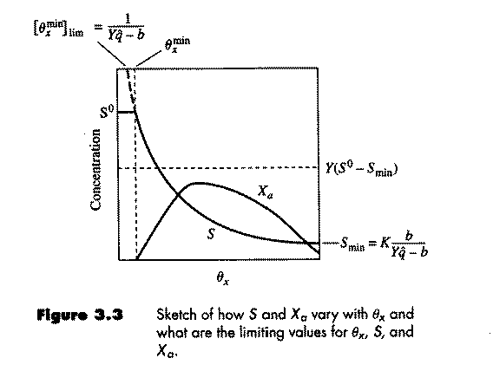
CSTR continued: Washout

Slide 19
CSTR with significant influent biomass (X_{a}⁰)

Slide 21
Batch and PFRs (assuming negligible decay)
Where ϴ= V/Q = A*L/Q

Slide 22
Impact of starting inoculum level (X_{a}º)

Slide 24
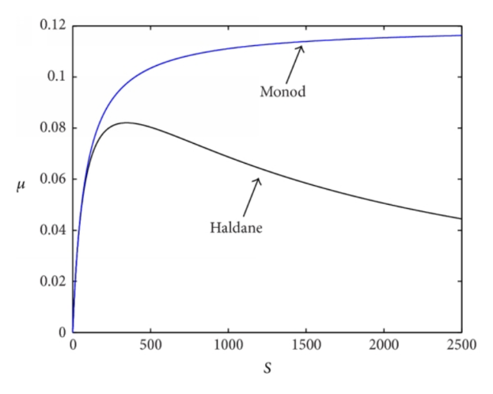
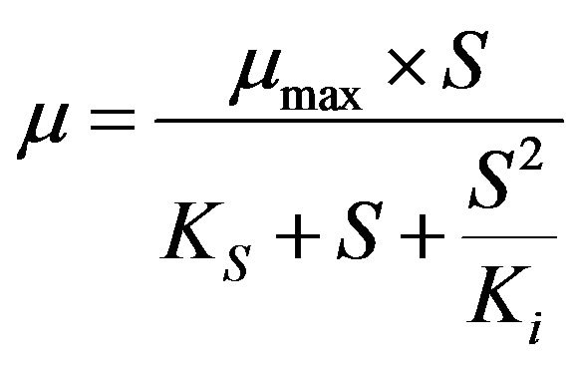
Inhibition impacts on enzyme kinetics
Competitive inhibition
Noncompetitive inhibition
Substrate inhibition (“Haldane”)

Slide 26
Organic functional groups that undergo biotransformations
Some common industrial chemicals/pharmaceuticals
Which functional groups can you identify?

Slide 27
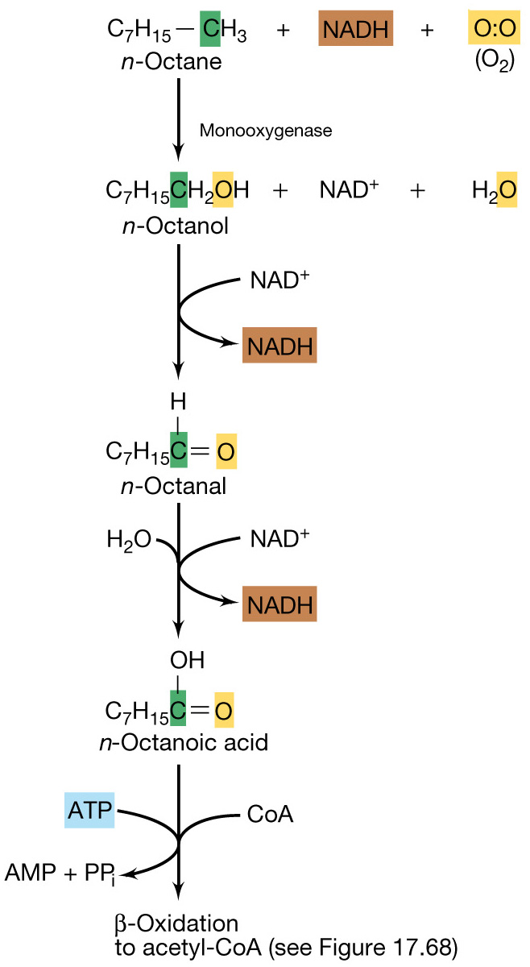
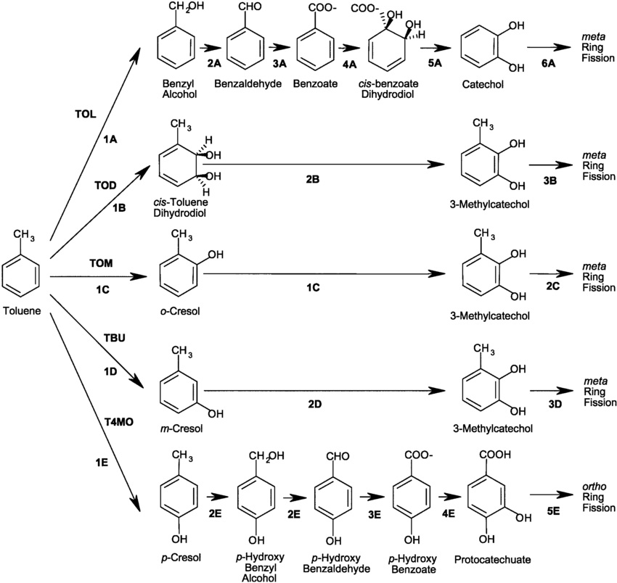
Aromatics and alkanes/alkenes
Hydrocarbon oxidation

Slide 28
Chloroorganics’ biodegradation

Slide 29
Other classes of contaminants
Polymers
Metals

Slide 30
Acclimation: why is there usually a lag before contaminant biodegradation?

Slide 31
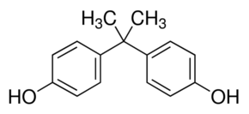
New strategy to support removal of emerging contaminants in wastewater
Constant low level inoculation of bacterial cultures that degrade contaminants
Since contaminants may enter the WW plant only occasionally or at widely varying concentrations over time, the “activated sludge” might not have the right biodeg’ve enzymes at high enough levels
Bisphenol A (BPA)

Slide 32
Evolution of enzyme pathways
Mutation
Recombination by Horizontal Transfer

Slide 33
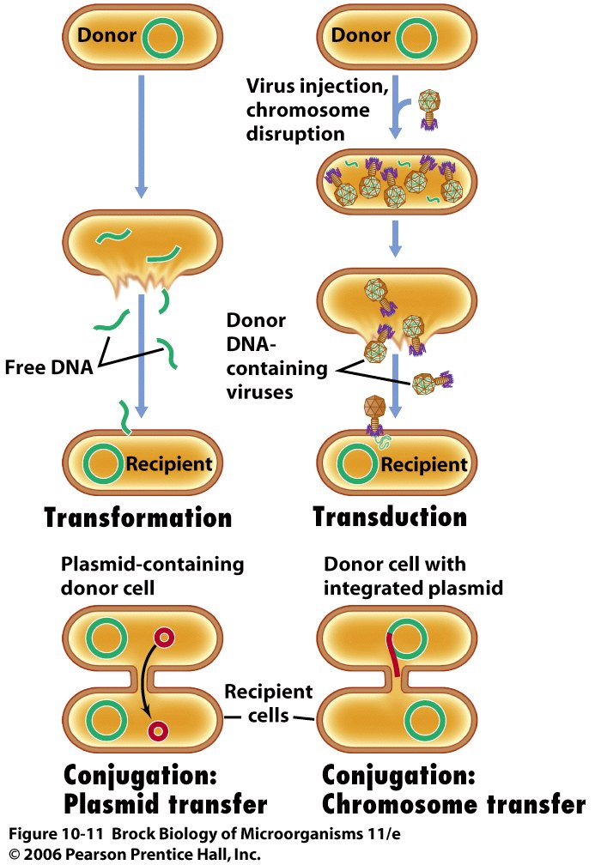
3 mechanisms of HGT:
Transformation
Transduction
Conjugation
Notes:
. In procaryotes, it’s a one-way (nonreciprocal)
process; a piece of genetic material (the exogenote) from one organism is
donated to the genome (endogenote) of the recipient. This can happen three
Ways:
Recombination: exchange of DNA from one source to another, where it is incorporated; process of creating a new genotype by combining genetic material from two organisms. In prokaryotes, it’s a one-way (non-reciprocal) process; piece of genetic material (exogenote) from one organism is donated to the genome (endogenote) of the recipient)

Slide 35
DNA/RNA molecular techniques

Slide 36
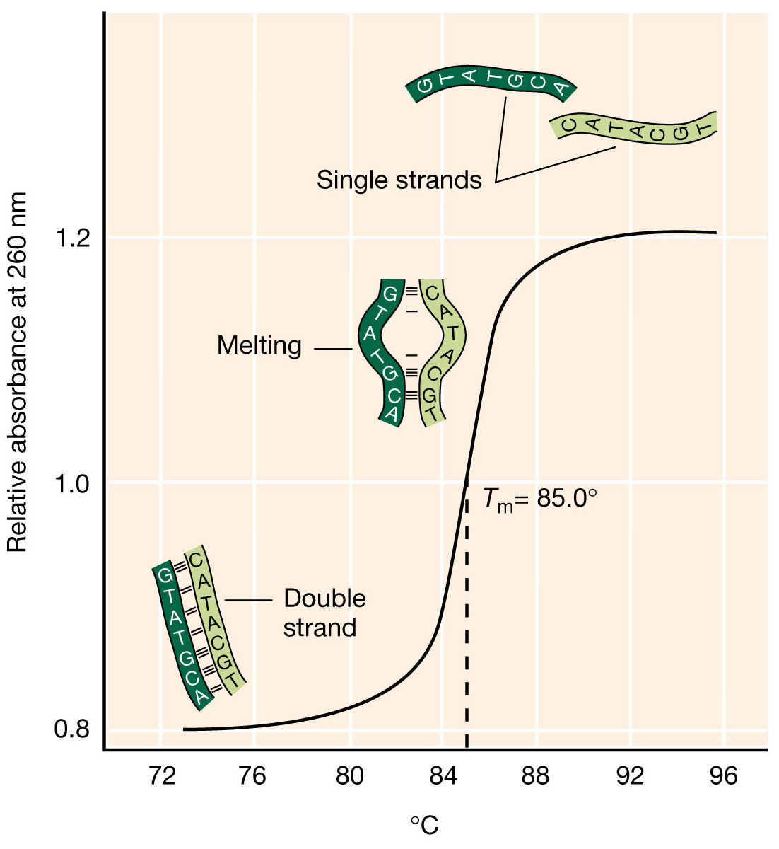
Notes:
Figure: 07-09
Caption:
Thermal denaturation of DNA. The DNA absorbs more ultraviolet light as the double helix is denatured. The transition is quite abrupt, and the temperature of the midpoint, Tm, is directly related to the GC content of the DNA. Although the denatured DNA can be renatured by a slow cooling, the process does not follow a similar curve. Renaturation becomes progressively more complete at temperatures well below the Tm, and then only after a considerable incubation time.

Slide 37
Nucleic Acid Detection Techniques: Hybridization is key to specificity of assays
Technique | Target | Hybridization occurs between
PCR (including TRFLP & sequencing PCR) | DNA | Primers:DNA
qPCR (RTqPCR) | DNA | Primers:DNA & Probe: DNA
RTPCR | RNA | Primer:RNA & Primers:DNA
FISH or blotting | rRNA or DNA | probe:rRNA or probe: DNA
Microarrays | Fluor labeled cDNA | Immobilized probe: cDNA

Slide 38
PCR “Ingredients”:
Template DNA (from which target region will be amplified)
Forward and reverse primer
Deoxynucleoside triphosphates (dNTPs)
Cations (usually Mg²⁺)
Taq DNA polymerase
Notes:
the building-blocks from which the DNA polymerase synthesizes a new DNA strand.

Slide 39
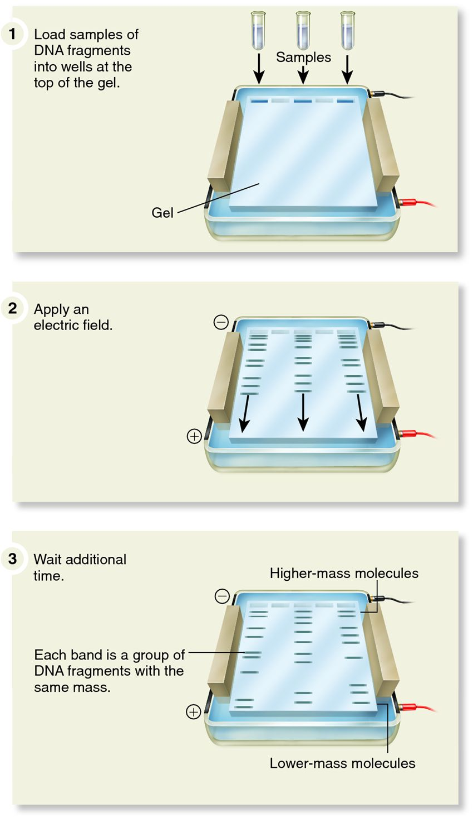
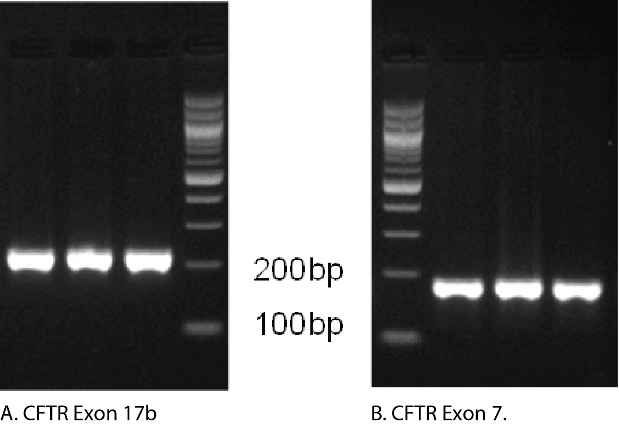
Detecting and sizing “amplicons” following PCR: Gel Electrophoresis
https://www.idtdna.com/pages/decoded/decoded-articles/core-concepts/decoded/2014/01/20/interpreting-melt-curves-an-indicator-not-a-diagnosis
http://biology-forums.com/index.php?topic=3166.0

Slide 40
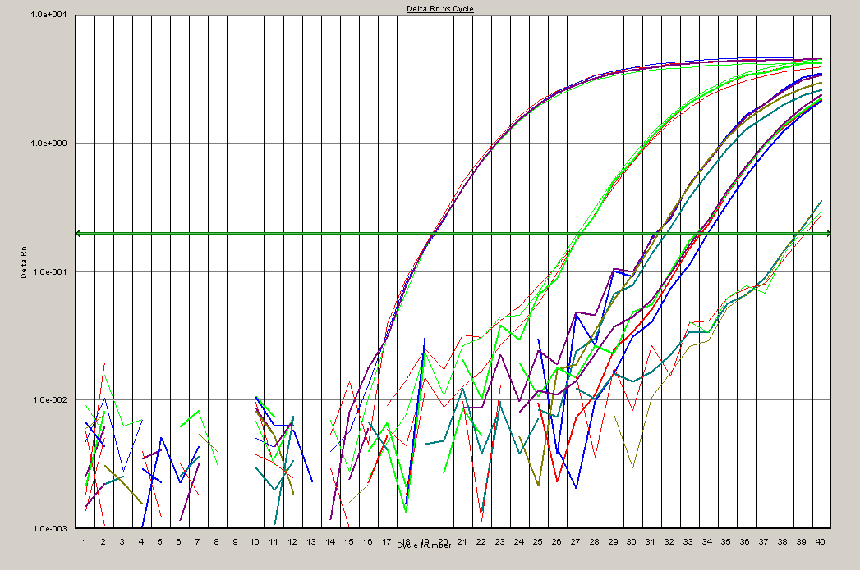
Quantitative PCR (qPCR): run samples alongside standard curve
73 copies/μL
290 copies/μL
2,900 copies/μL
290,000
copies/μL
fluorescence (log scale)
7 copies/μL
0
10
20
30
40
PCR cycle number

Slide 41
Fluorescent in situ Hybridization (FISH)
with an rRNA-targeting probe
Target organism with many ribosomes
Visible under microscope
Benefit: specific populations can be counted directly under the microscope
Limitations:
Each probe must be optimized (time consuming)
If the organism has few ribosomes, signal is weak or nondetectable
Membrane permeability issues

Slide 42
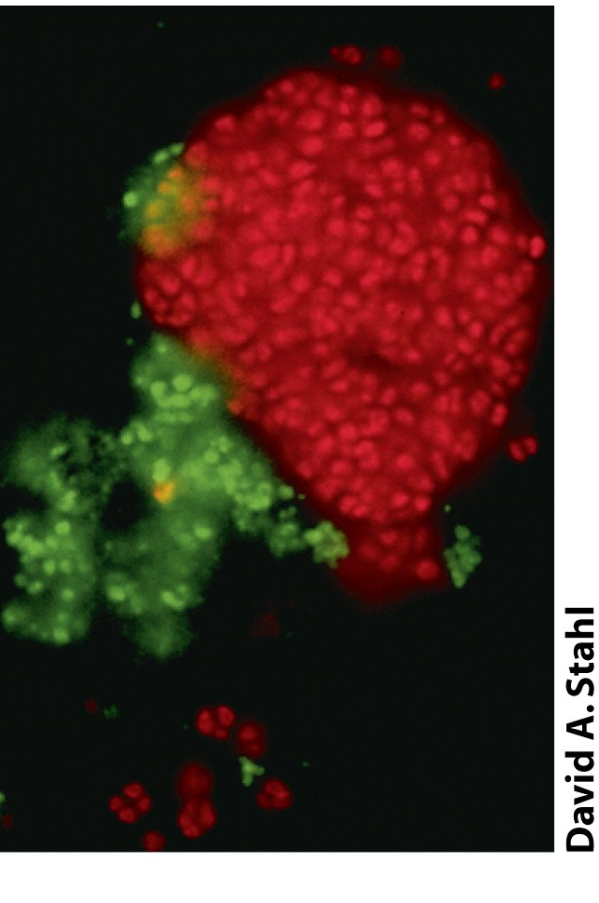
FISH with 16S rRNA probes
Detection of nitrifying bacteria in granule of activated sewage sludge
Red: ammonia-oxidizing bacteria
Green: nitrite-oxidizing bacteria
The 16S is also a good target because cells contain many ribosomes!
Notes:
Use of phylogenetic strains to make nitrifying bacteria visible in a granule of activated sewage sludge. Left is phase photomicrogrpah. Right is after applying prove that fluoresces red is speciific for 16S rRNA of ammonia-oxidizing bacteria, while probe that fluoresces green is specific for sequence only in nitrite-oxidizing bacteria.
Benefit: specific populations can be counted directly under the microscope
Limitations:
Each probe must be optimized (time consuming)
If the organism has few ribosomes, signal is weak or nondetectable
Membrane permeability issues

Slide 43
RT-qPCR: reverse transcription qPCR
RNA from culture
cDNA
qPCR
73 copies/μL
Reverse Transciption
(RT)
290 copies/μL
2900 copies/μL
qPCR
fluorescence (log scale)
290000
copies/μL
7 copies/μL
0
10
20
30
40
PCR cycle number

Slide 44
Nucleic Acid Detection Techniques: Hybridization is key to specificity of assays
Technique | Target | Hybridization occurs between
PCR (including TRFLP & clone libraries) | DNA | Primers:DNA
qPCR (RTqPCR) | DNA | Primers:DNA & Probe: DNA
RTPCR | RNA | Primer:RNA
FISH | rRNA | Fluor probe:rRNA
Microarrays | Fluor labeled cDNA | Immobilized probe: cDNA

Slide 45
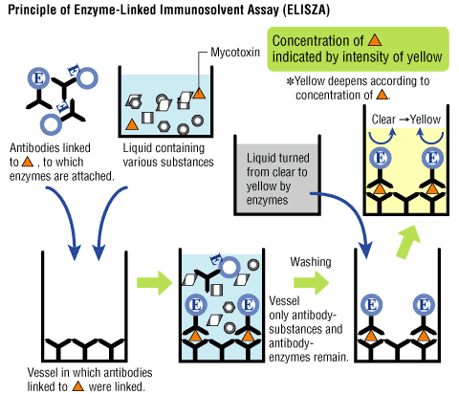
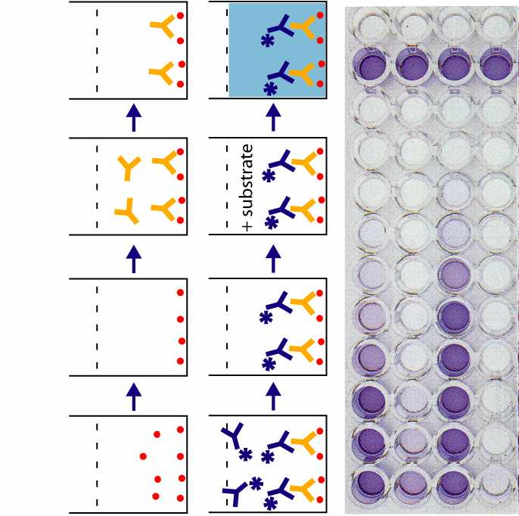
ELISA- Enzyme-Linked Immunofluorescence Specific Assay Example of Sandwich assay
http://microvet.arizona.edu/Courses/MIC419/ToolBox/elisa.html

Slide 46
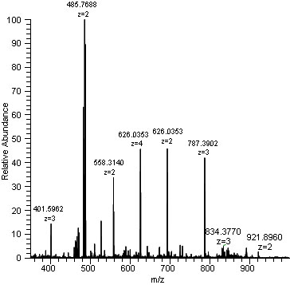
Mass spectrometry: analytical chemistry technique that measures mass-to-charge ratio of gas-phase ions
Proteomic analysis on bacterial “proteomes” requires a sequenced genome—identify proteins based on specific peptides based on genome annotation
Notes:
When thinking about identifying proteins from bacteria protein sample, match up with genome, have expected peptides that could be identified in mixture, match back to particular protein
A mass spectrum (plural spectra) is a plot of the ion signal as a function of the mass-to-charge ratio. The spectra are used to determine the elemental or isotopic signature of a sample, the masses of particles and of molecules, and to elucidate the chemical structures of molecules, such as peptides and other chemical compounds. Mass spectrometry works by ionizing chemical compounds to generate charged molecules or molecule fragments and measuring their mass-to-charge ratios.

Slide 47
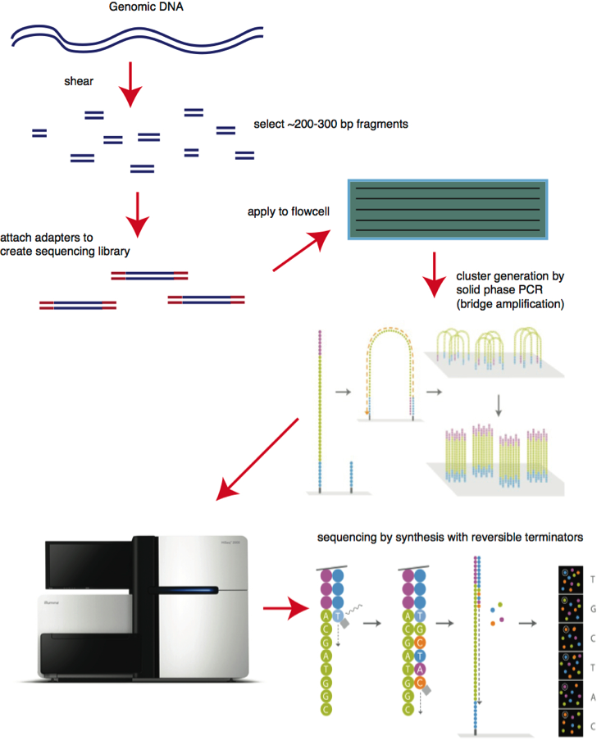
Next Generation sequencing: “Illumina”
Amplicons from PCR
PCR
Millions of individual amplicons sequenced and results can be used to:
Determine community composition (eg. 16s rRNA gene amplicons)
Assemble entire gneomes of novel microorganisms/communities
YouTube videos:
https://www.youtube.com/watch?v=tuD-ST5B3QA
https://www.youtube.com/watch?v=-7GK1HXwCtE

Slide 48
Common uses of “Next Gen” sequencing data
Community analysis (“who” is in a community? “who” is active)
Amplicon analysis (like 16 S rRNA amplicon surveying)
Assembly of longer lengths of DNA sequence (e.g. Genome sequence)
EXERCISE with pipe segments

Slide 50
Molecular tools for Profiling of cultures/communities
Methods include:
DGGE Denaturing Gradient Gel Electrophoresis
TRFLP: terminal fragment length polymorphism analysis.
Amplicon analysis by high throughput sequencing

Slide 51
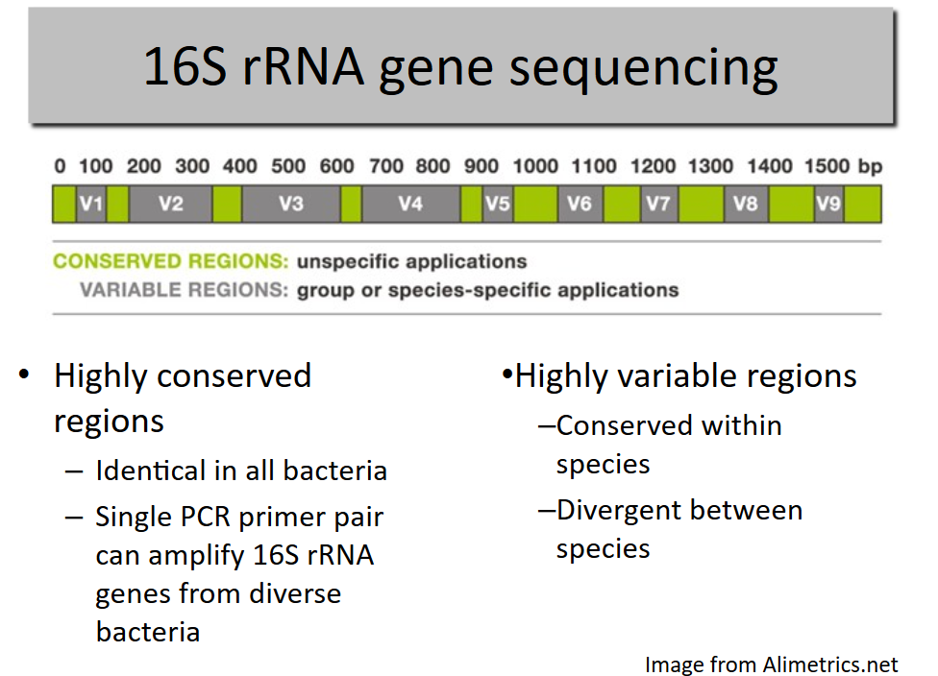
Recall that the 16S rRNA gene has conserved and variable regions

Slide 52
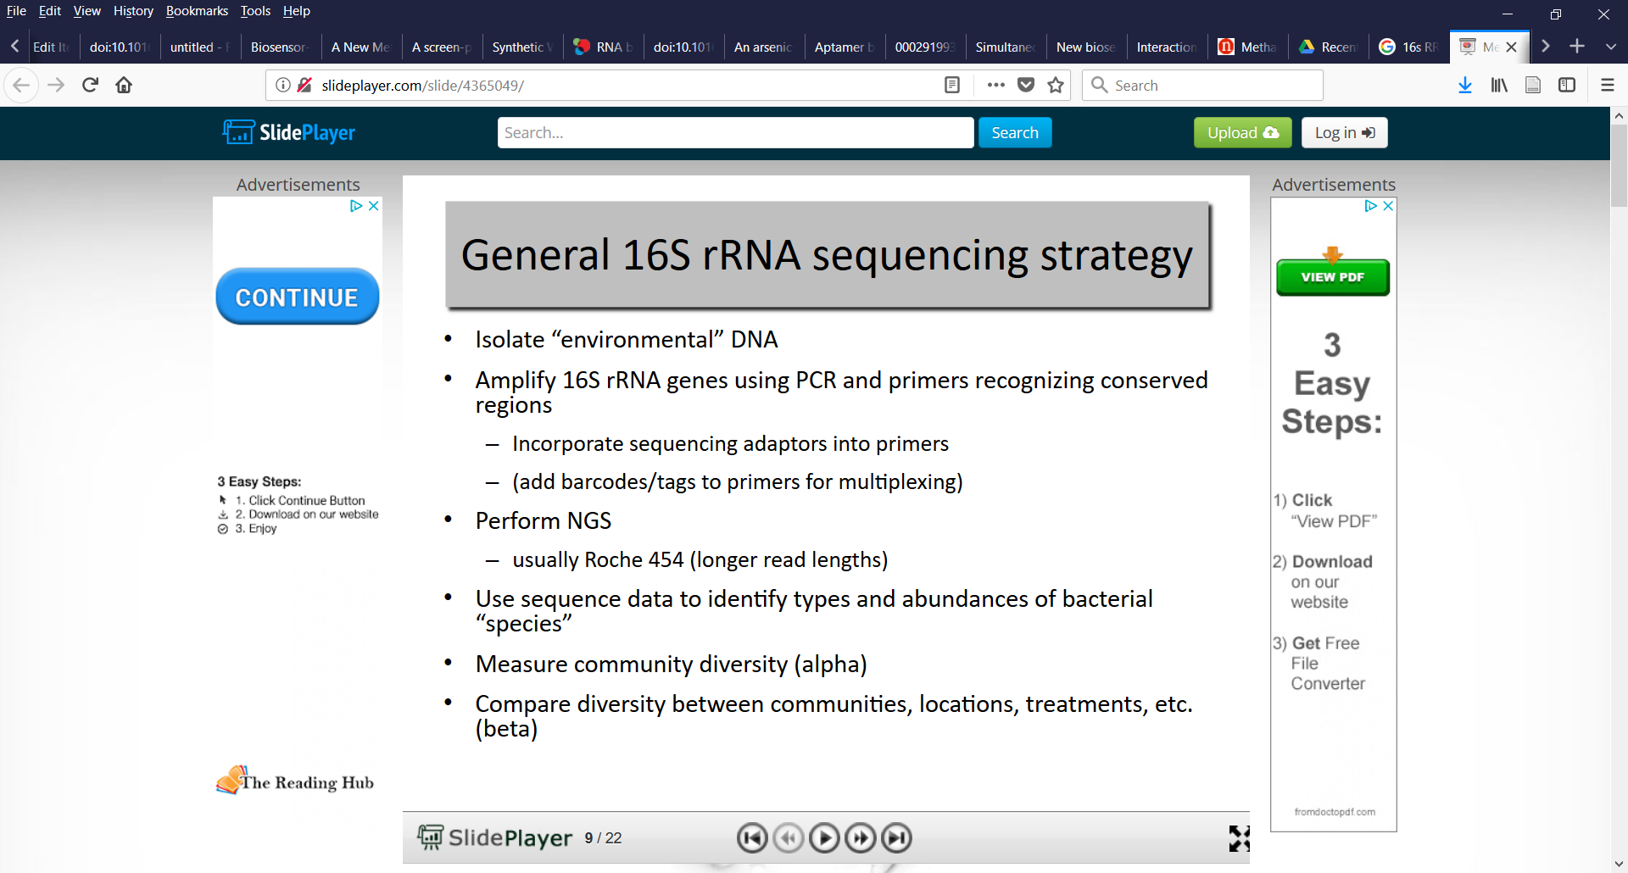
High Throughput 16S rRNA gene Amplicon sequencing

Slide 53
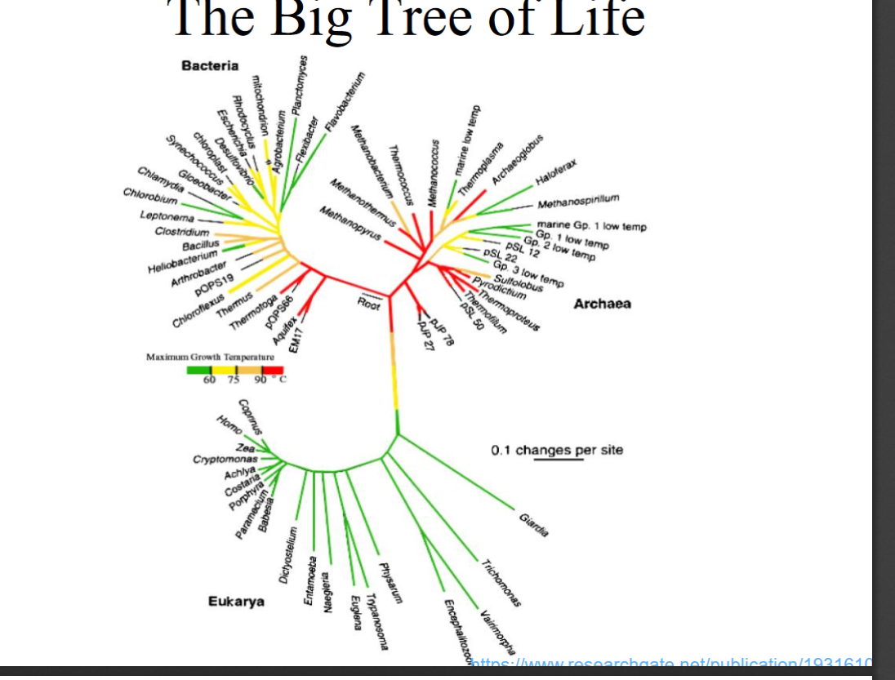

Slide 54
Terminal Restriction Fragment Length Polymorphism (T-RFLP) Analysis: PCR with 16S rRNA primers
rDNA
Species A
Species B
Species C
h
Species D
Species E
Fluorescent primer
Restriction Enzyme cut site

Slide 55
Terminal Restriction Fragment Length Polymorphism (T-RFLP) Analysis
C
A
B
E
D
Species A
Species B
Resulting community profile after
electrophoresis (small fragments
travel quickest and come off gel
fastest
Species C
h
Species D
Limitations:
Prediction of specific species from a T-RF length can be difficult
Unlike DGGE can’t extract and seq fragments
Species E
Fluorescent primer
Restriction Enzyme cut site

Slide 57
Biomarkers (BMs)
A biomarker is quantifiable characteristic of biochemical, physiological, toxicological or ecological process or function that has been correlated or causally linked to effects.
NOTE: Bioindicator & Biomarker are terms used interchangably – largely personal preference
From McCarty et al. 2002 (Hum. Ecol. Risk Assess.)

Slide 58
Biomarker results possible:
 | BM assay positive? | Bioremediation occurring? | Possible problem w/BM assay
True + | Yes | Yes | -
False + | Yes | No | Not Specific
True - | No | No | -
False - | No | Yes | Not Robust

Slide 59
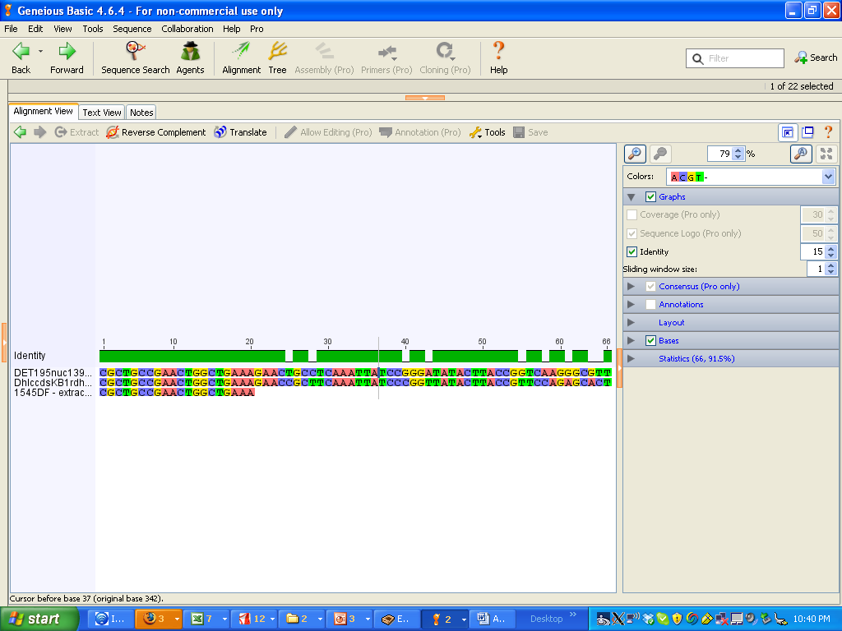
Reasons for False + and False -
Reasons for False +
Contamination
Presence of the BM not linked to process of interest
DNA BM may not be expressed as RNA,protein
BM not “specific” to process
“cross-talk” due to non-specific hybridization to non-target BM
Reasons for False –
Poor recovery of biomolecules from site
Inhibition of BM assay by co-extracted compounds
The BM is not “robust” enough (the process is happening but BM list/assay insufficient)
Primer targets region that may vary in diff’t versions of a gene
Entirely diff’t genes responsible
Primer or probe

Slide 60
Criteria for Bioremediation Biomarkers
Scientific criteria:
specificity (are they specific to process of interest?)
robustness (are they crucial to the process of interest?)
temporal sensitivity (are they indicative of current activity?)
quantitative correlation w/process rates (can they inform modeling efforts?)
Logistical criteria:
amount and type of field sample needed
equipment or expertise needed
interference from non-target organisms (false positives and false negatives) or abiotic factors
ease of data interpretation

Slide 61
Biomarkers (BMs)
A biomarker is quantifiable characteristic of biochemical, physiological, toxicological or ecological process or function that has been correlated or causally linked to effects.
NOTE: Bioindicator & Biomarker are terms used interchangably – largely personal preference
From McCarty et al. 2002 (Hum. Ecol. Risk Assess.)

Slide 62
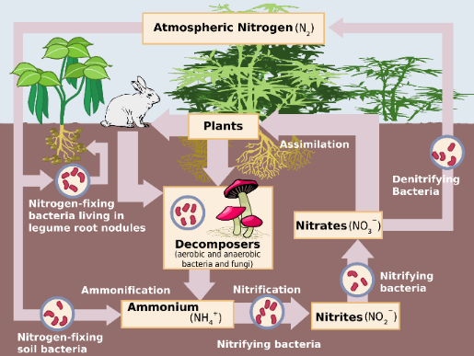
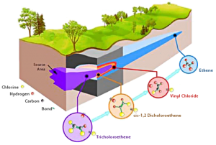
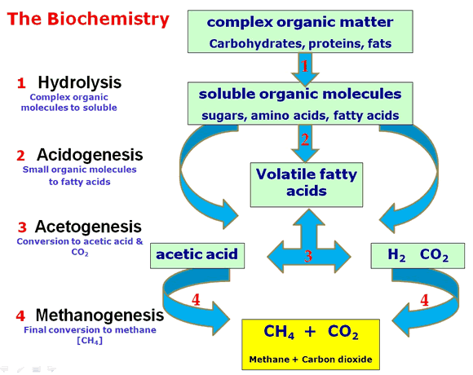
Basic Objective: Monitoring and quantifying specific microbial processes in complex settings
Bioremediation
Nutrient cycling
Wastewater treatment
Bioenergy
Green chemistry
Greenhouse gas cycling
Pathogen presence/risk level
https://en.wikipedia.org/wiki/Nitrogen_cycle
http://followgreenliving.com

Slide 63
E.g. of biomarkers for in situ bioremediation: Recall the overlapping lines of evidence needed to document Biorem?
Contaminant(s) concentration is decreasing
Microorganisms (MOs) from the site are capable of catalyzing the biodegradation of the contaminant(s)
The biodegradative capability of the MOs is being realized under field conditions.
Well-selected biomarkers can address Criteria 2 & 3 simultaneously
Ideally, they also relate to RATES of bioremediation (inform forecast modeling)

Slide 64
Criteria for Bioremediation Biomarkers
Scientific criteria:
temporal sensitivity (are they indicative of current activity?)
quantitative correlation w/process rates (can they inform modeling?)
specificity (are they specific to process of interest?)
robustness (are they crucial to the process of interest?)
Notes:
64

Slide 65
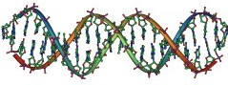
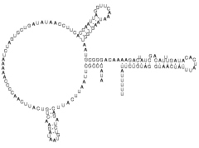
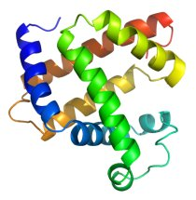
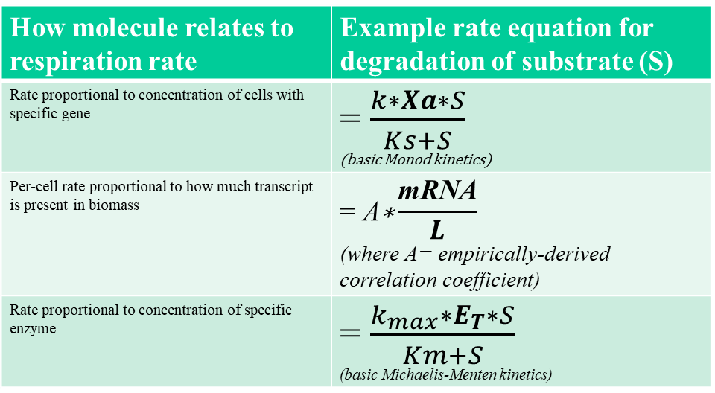
Using Biomarkers for rate predictions
How molecule relates to respiration rate | Example rate equation for degradation of substrate (S)
Rate proportional to concentration of cells with specific gene
Per-cell rate proportional to how much transcript is present in biomass
Rate proportional to concentration of specific enzyme
DNA
RNA
Protein

Slide 66
The cycle of Discovery and Application of Biomarkers
Basic Science: Understanding the systems biology of bioremediation cultures
Core genome (metabolism, regulation, stress response, hypothetical proteins)
Function and regulation of strain-specific genes
Nature of community members’ interactions
Usually involves biochemical and/or omics surveys
Applied Science: Monitoring field-scale bioremediation through “biomarkers”
Which biomarkers could be used to document specific processes? Stress response? In situ rates?
Usually involves targeted quantification of specific DNA/RNA/protein biomolecules
Challenges: representative sampling; complexity
Notes:
66

Slide 67
Biomarker results possible:
 | BM assay positive? | Bioremediation occurring? | Possible problem w/BM assay
True + | Yes | Yes | -
False + | Yes | No | Not Specific
True - | No | No | -
False - | No | Yes | Not Robust

Slide 68
Regulation of Expression
Constitutive: enzymes maintained in cell constantly around same level
More commonly, expression is regulated
Amount, presence/absence
Level of transcription or translation
Activity of pre-existing enzymes
Posttranslationally (e.g. allosteric enzymes)
Notes:
So as we start talking about regulation, one important word that is kind of the opposite of regulation is constitutive, so we’ve heard this word before and it’s basically the idea that these are enzymes that are always needed in the cells around the same level and therefore always turned on to that level and not regulated. More commonly, however, expression is regulated. Can somebody describe the iwhat they think the importance of regulation is?
Transcription especially, as half life of rnas so short, can make a lot of a little…
Transcription—varying the amount of messenger RNA or translation, translating or not translating the mRNA
There are two levels of control which are employed: control over the synthesis
of the enzyme (providing a sort of "coarse control"); and regulation of the
activity of an enzyme after it has been synthesized (constituting what might be
termed "fine tuning").

Slide 69
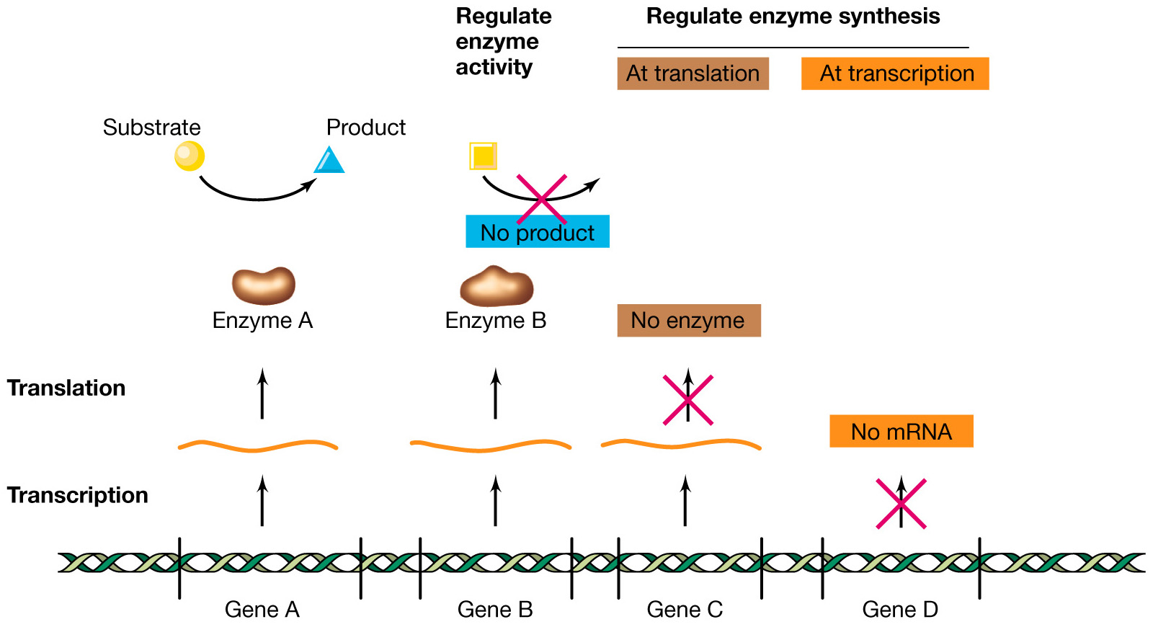
Overview of regulation
Brock figure 8-01
Notes:
So here’s
Caption:
An overview of the mechanisms that can be used in regulation. The product of gene A is enzyme A, which is synthesized constitutively and carries out its reaction. Enzyme B is also synthesized constitutively but its activity can be inhibited. The synthesis of the product of gene C can be prevented by control at the level of translation. The synthesis of the product of gene D can be prevented by control at the level of transcription.

Slide 70
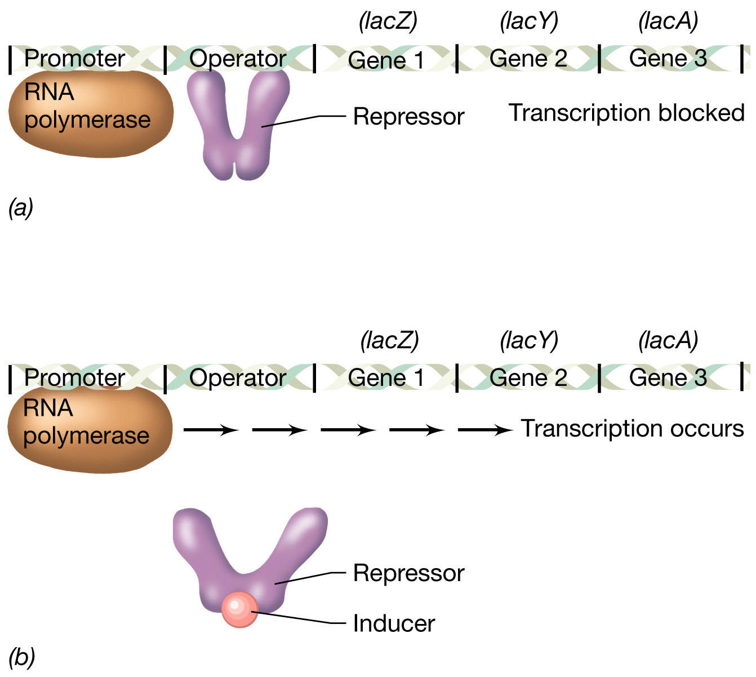
Induction using a repressor in the lac operon. Still technically negative control.
LacZ encodes Β-galactosidase
Brock Figure 8-13a-b
Notes:
(a derivative of lactose or the analog IPTG) The inducer inactivates the repressor
Caption:
The process of enzyme induction using a repressor. (a) A repressor protein binds to the operator region and blocks the action of RNA polymerase. (b) An inducer molecule binds to the repressor and inactivates it so that it no longer can bind to the operator. Transcription by RNA polymerase occurs and an mRNA for that operon is formed. In the case of the lac operon the repressor would be the lac repressor, and the inducer would be allolactose.

Slide 71
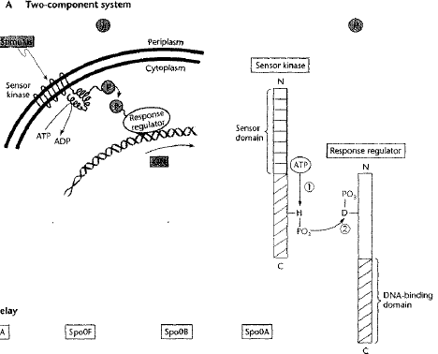
Simple signal transduction: two component regulatory systems
Effect
Histidine sensor kinase & response regulator

Slide 72
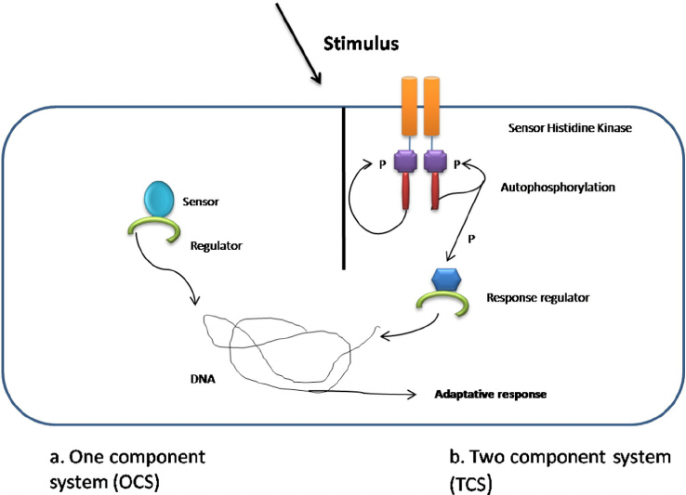
Signal transduction
https://www.researchgate.net/figure/One-component-and-two-component-signal-transduction-systems-a-A-prototypical_fig1_278787131

Slide 73
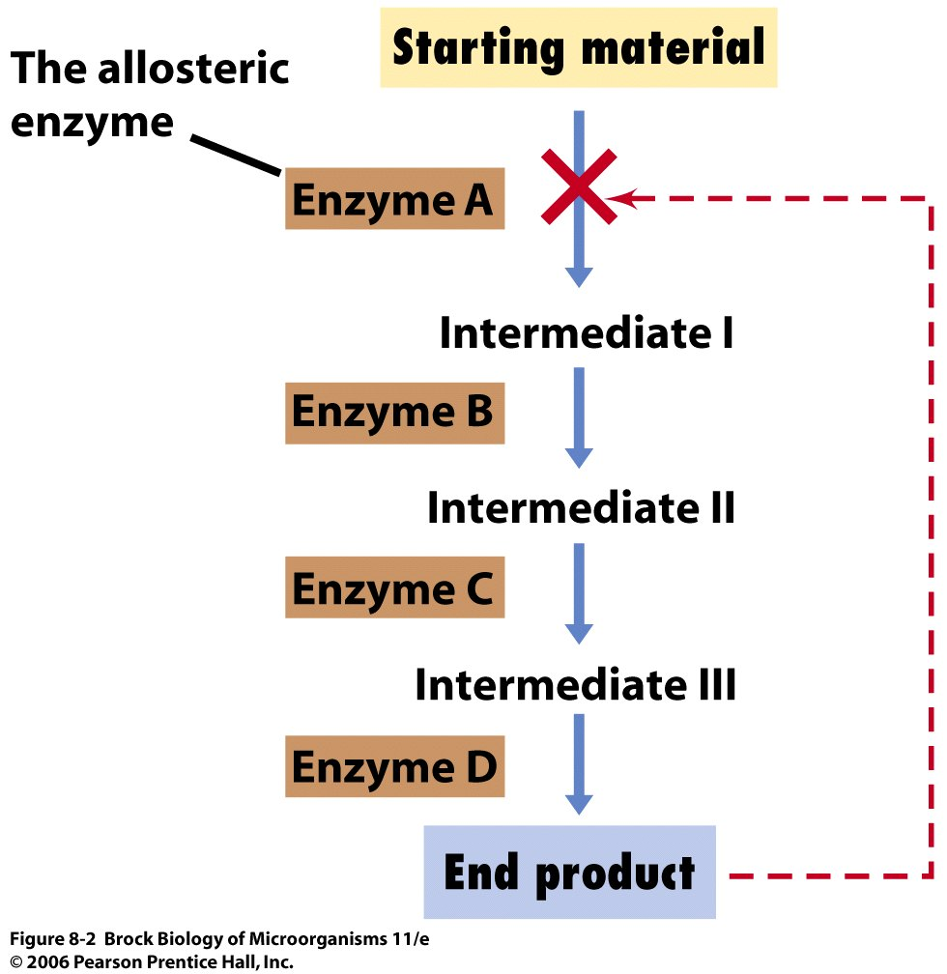
Regulation at level of activity
Notes:
Common in anabolic and catabolic pathways. End product can commuinicate with earlier step, regulate its own biosynthesis. It’s reversible though, as once the inhibitor becomes limiting, synthesis resumes.

Slide 74
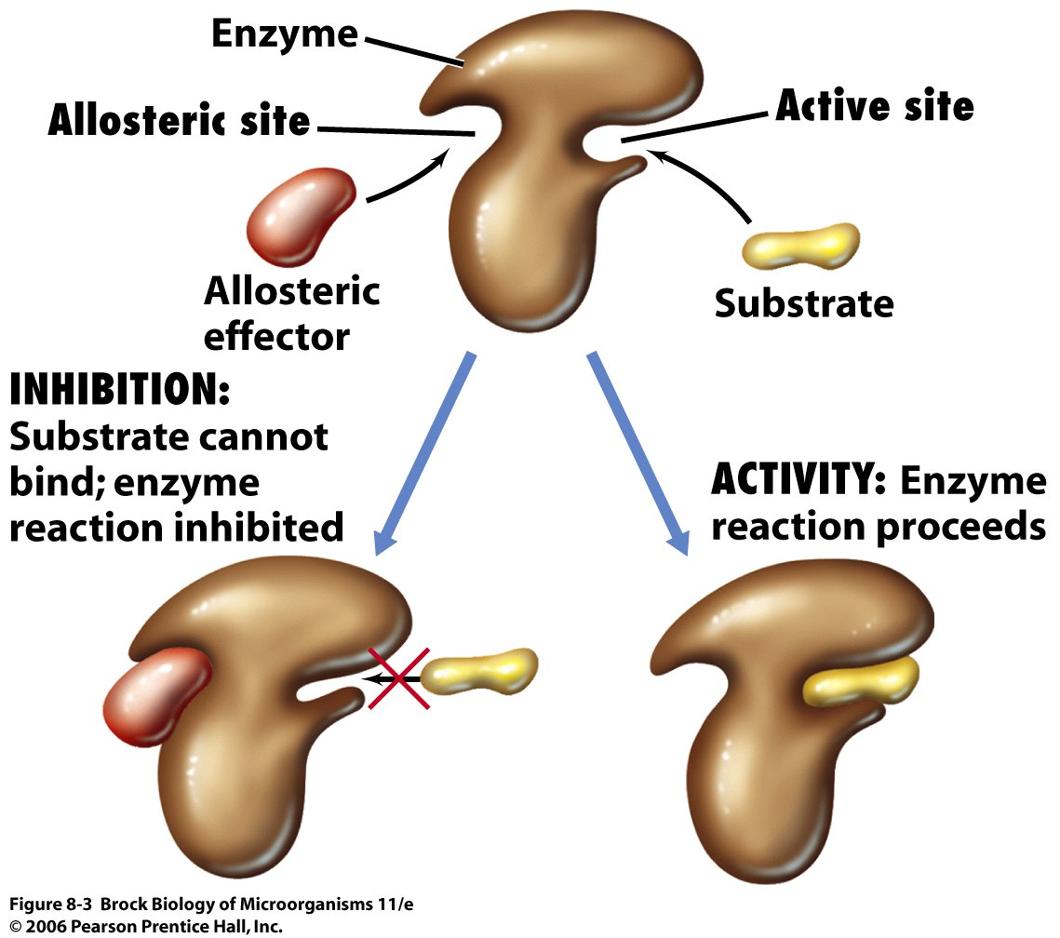
Allosteric enzymes have two binding sites, the active site where the substrate binds and the allosteric site where the effector binds
Notes:
So we’ve been talking about regulation at the level of transcription, so affecting how many transcripts of a particular enzyme are made, which then will in some way relate to how much of that enzyme is actually made. The level of translation can also play in here, but we’re not going to get into that. We’re now going to talk about one exmaple of regulation of enzyme at the level of activity… so not altering the actual amount of the enzyme but isntead affecting how active that enzyme is.

Slide 76
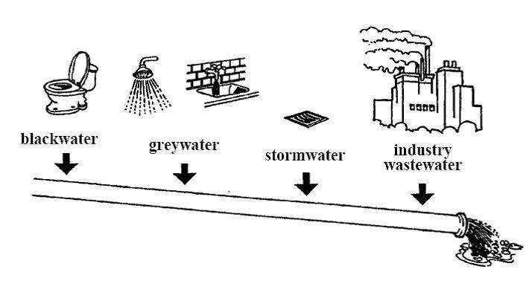
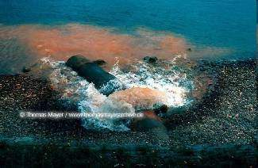
Unsustainable current approaches: Mixing what shouldn’t be mixed..
With conventional waterborne flush-toilets, we mix
roughly 50 kg of faecal matter (per person/year)
50 kg
roughly 500 l of urine (per person/year)
500 L
with roughly 20’000l of clean flushwater*
20’000 L
If this wastewater is discharged untreated into rivers, an even higher amount of water is polluted!
http://thomasmayerarchive.de
*Based on an average for a toilet that uses about 8 L of Water per flush (11).
Notes:
76
This is a figure based on the Swiss average, for a toilet that uses about 8 L of Water per flush. However, toilets (mainly in North America) can use up to 5 Gallons (roughly 23l) just for one flush! This would add up to a water use (just for flushing!!) of almost 50’000 l per person and year – and the fact that the polluting substances make up just 1 % of the total wastewater!

Slide 77
Characteristics of waste products
Introduction
 | Total | Greywater*** | Urine | Faeces
Volume [l/cap·yr] | 25’000-100’000 | 25’000-100’000 | 500 | 50
Nutrients Nitrogen | 2 - 4 kg/cap·yr | 5% | 85% | 10%
Phosphorous | 0.3 - 0.8 kg/cap·yr | 10%** | 60% | 30%
Potassium | 1.4 - 2.0 kg/cap·yr | 34% | 54% | 12%
COD (organic material) | 30kg/cap·yr | 41% | 12% | 47%
Faecal coliforms | - | 10⁴-10⁶ /100ml | 0* | 10⁷-10⁹ /100ml
* healthy people
** can be as high as 50%, depending on washing and dish-washing powder used
*** values representative for industrialized countries
Notes:
Key messages:
Greywater, urine and faeces have distinct characteristics.
When dealing with waste products, it is important to account for their value and potential risks.
Next slide: Characteristics of waste products in words
Additional information & questions (also on next slide!):
Urine: Contains almost all the nitrogen and large parts of the potassium and phosphorous excreted by humans. N:P:K = 10:1:2 Urine is usually sterile (exceptions known by urinary tract infections).
Faeces: Mainly undigested organic matter made up of carbon. Faeces contain almost all pathogens:
bacteria (e.g. faecal coliforms, vibro cholerae)
viruses (e.g. rota virus)
protozoa (e.g. amoeba hystolitica)
helminths (e.g. Ascaris eggs)
Low nutrient content, but good characteristics as soil conditioner
Greywater:
Greywater is defined as household wastewater without input of human excreta
It includes used water from baths, showers, hand basins, washing machines, dishwashers, laundries and kitchen sinks
Big quantities with relatively low nutrient contents.
Big reuse potential:
Irrigation: Agriculture, landscape, aquaculture
Municipal uses: Fire protection, street cleaning, car washing, cooling, road construction operation, ...
Non-potable domestic uses: Toilet flushing, laundry, floor cleaning
Main issue: Toxic substances (organic compounds, metals, chlorine etc.), fats from kitchen, can affect natural treatment and disposal systems
Which constituents cannot be removed from waste products by most treatment technologies? How can that problem be solved?
Why is the volume an important parameter for describing waste products?
Are the nutrients in faeces readily available?

Slide 78
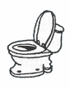
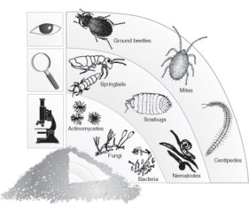
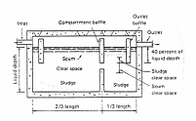
Sanitation: What are the Functional Groups through which the products flow?
Systems and Technologies
Technologies which perform the same, or similar function, are grouped into „Functional Groups“
User Interface
Use
and/or Disposal
Collection
and Storage/ Treatment
(Semi-)
Centralised
Treatment
Conveyance
e.g. Dry Toilet or Pour Flush Toilet
e.g. Composting
or Leaching Field
e.g. Anaerobic
Baffled Reactor
or Waste Stabilisation
Pond
e.g. Septic
Tank
e.g. Simplified
Sewer or
Tank Lorries
Input products
safe & valuable output products
Notes:
Key messages:
A sanitation system is a combination of technologies through which the products flow.
Technologies which perform the same, or similar function, are grouped into „Functional Groups“
Next slide: How can the Functional Groups be linked?
Additional information & questions:
User interface describes the type of toilet, pedestal, pan or urinal the user comes in contact with. User interface also determines the final composition of the product, as it is the place where water is introduced in the system. Thus, the choice of user interface is often dependent on the availability of water.
Collection and storage/treatment describes the ways of collecting and storing products generated at the user interface; storage often also performs some level of treatment.
Conveyance describes the way in which products are moved from one process to another. Although products may need to be moved in various ways to reach the required process, the longest and most important gap lies between on-site storage and (semi-) centralised treatment. For the sake of simplicity, conveyance is thus limited to moving products at this point.
(Semi-) centralised treatment refers to the treatment systems which, unlike those used on-site, are larger, require a greater inflow (that can usually not be met by just one family) and often more skilled operation.
Reuse and disposal refers to the ways in which products are ultimately returned to the soil, either as harmless substances or useful resources. Furthermore, products can also be re-introduced into the system as new products. A typical example is the use of partially treated greywater used for toilet flushing.
Which processes are not required in certain sanitation systems?

Slide 79
Basic mass flows and processes in typical US WWTF
air
CO₂
Sewage
(raw WW)
Settling
Settling
Treated water
Aeration tank
Polishing
Anaer. Digester
Sludges
Biogas
Solids
Average electricity usage (wide range):
0.54 kWhr/cubic meter wastewater
(WW treatment is ~1-4 % of US electricity use

Slide 80
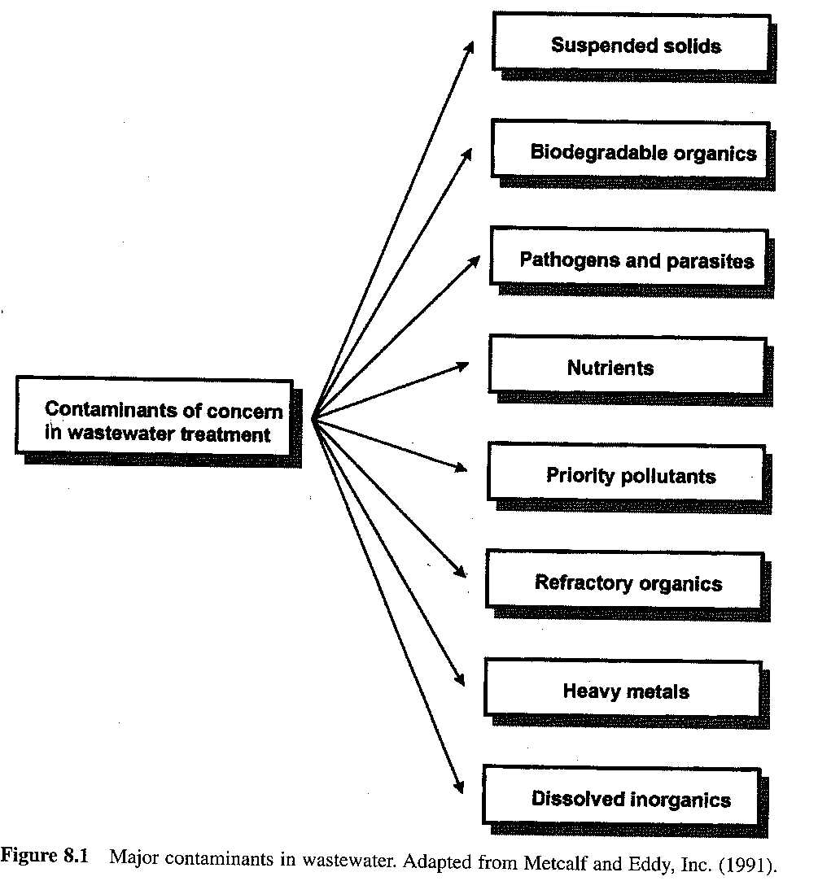
Notes:
Negative Effects? Human vs Ecological Health effects

Slide 81
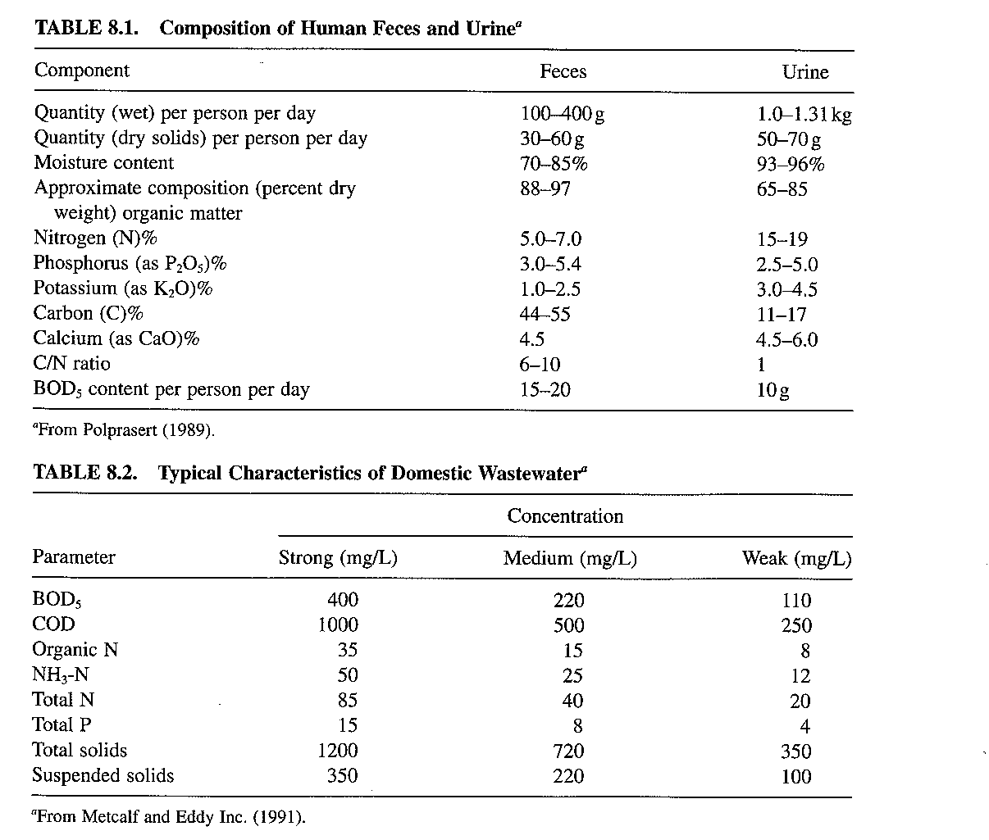

Slide 82
Methanogenesis in Anaer. Digesters

Slide 83
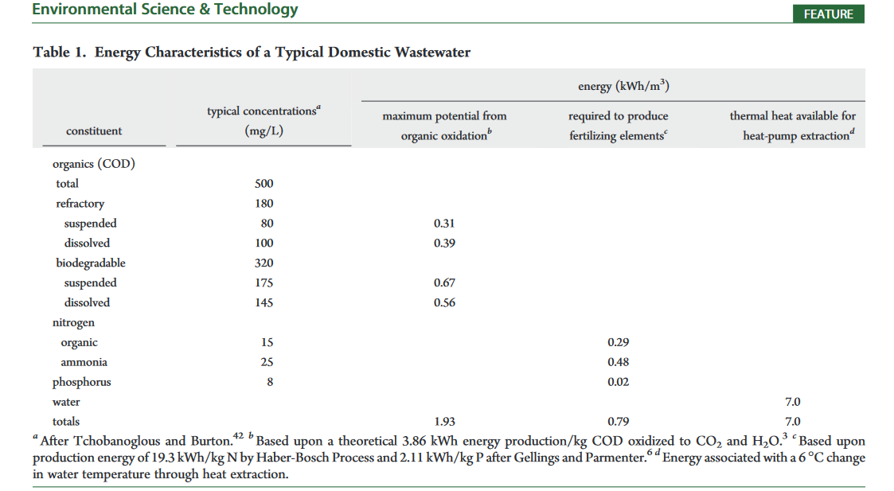
From McCarty, P.L., Bae, J., Kim, J., 2011. Domestic Wastewater Treatment as a Net Energy Producer–Can This be Achieved? Environmental Science & Technology 45, 7100–7106. https://doi.org/10.1021/es2014264

Slide 84
